Slide 1
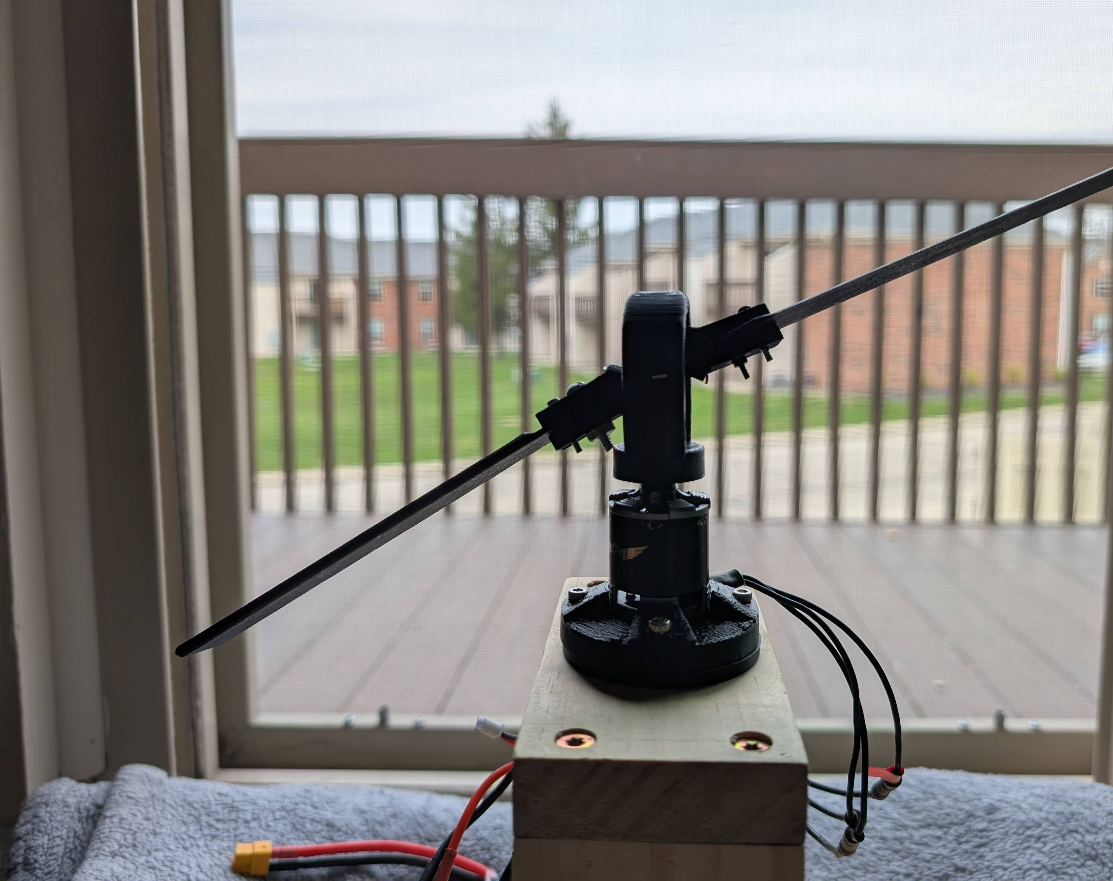
Control without a Swashplate for Small Helicopters
Departmental Honors Project
Mason McDaniel

Slide 2
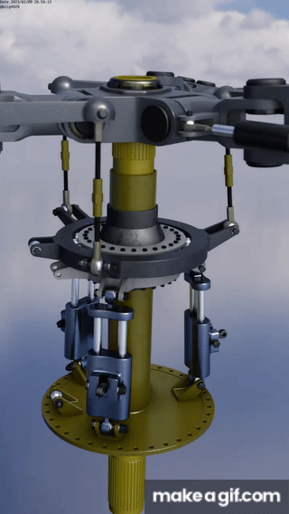
What's a Swashplate?
Individual blade pitch control
Raise and lower angle of attack
Controlled via the connected pitch links
Fine mechanical precision required

Slide 3
Virtual Swashplate
Articulated by simple pin joints
Skewed lag hinges
Positive lag-pitch coefficient
Negative lag-pitch coefficient
Torque is modulated in phase with the motor
Similar to sine wave modulation

Slide 4
How it was achieved
Hall effect sensor
Precise motor angle measurement
Flight controller
Conventional RC helicopter controller
Used for standard PID control loop
Arduino nano
Control Law

Slide 5
Hardware
What didn’t work
Arduino nano
Arduino Uno
What worked
Arduino Mega
Having 3 interrupts was necessary
Non-blocking attitude read in from FC

Slide 6
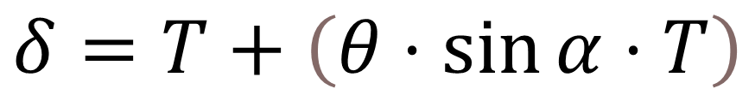
Control Law
Pitch (θ)
Roll (Φ)
Throttle (T)
Motor Angle (α)
Measured from hall effect sensor
PWM Signal (δ)
Output to motor
$$δ=T+\left(θ⋅\sin{α}⋅T\right)$$
* Induces Pitch in a single Direction
(Phase does not change)

Slide 7
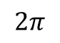

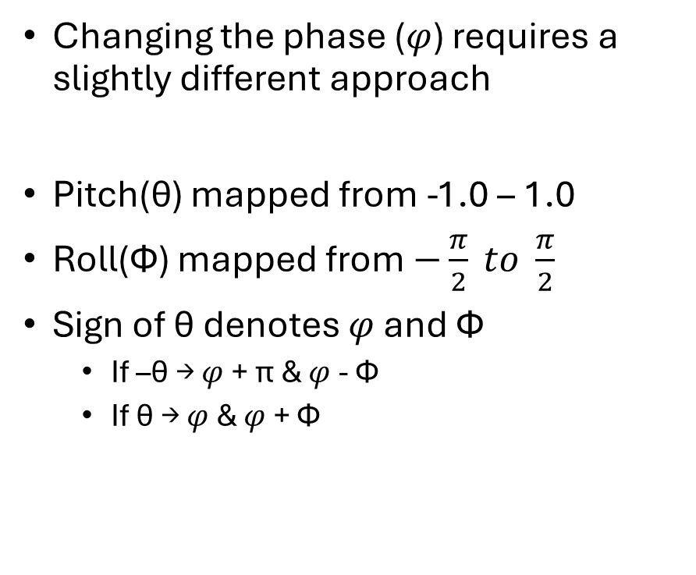
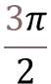
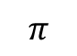
Control Law Cont.
$$2π$$
Φ
Changing the phase ($φ$) requires a slightly different approach
Pitch(θ) mapped from -1.0 – 1.0
Roll(Φ) mapped from $−\frac{π}{2} to \frac{π}{2}$
Sign of θ denotes $φ$ and Φ
If –θ → $φ$ + π & $φ$ - Φ
If θ → $φ$ & $φ$ + Φ
$$\left|θ\right|$$
$$\frac{3π}{2}$$
$$\frac{π}{2}$$
$$π$$

Slide 8
Demonstration

Slide 9
Future Works
Implement roll logic
Vibration Dampening
Material Analysis

Slide 10
Questions?

Slide 11
References
J. Paulos and M Yim, "Cyclic Blade Pitch Control Without a Swashplate for Small Helicopters," Journal of Guidance, Control and Dynamics, Jun. 2018, doi: 10.2514/1.G002683

